Slide 1


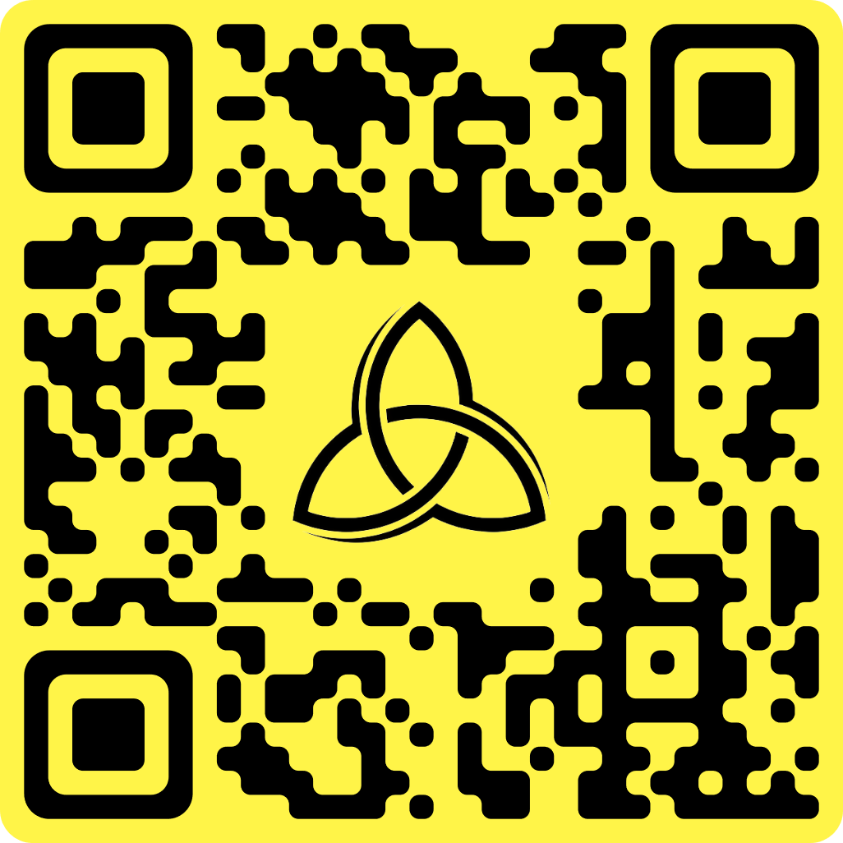

Scan the below QR Code to learn more about our courses:
emploskill.wixsite.com/emploskill
Catalogue of Courses
EMPLOSKILL PVT. LTD.
Sector 62 Noida, Gautam Buddha Nagar, Uttar Pradesh – 201309
Contact us: info.emploskill@gmail.com
emploskill.wixsite.com/emploskill
+91 81217 56657

Slide 2
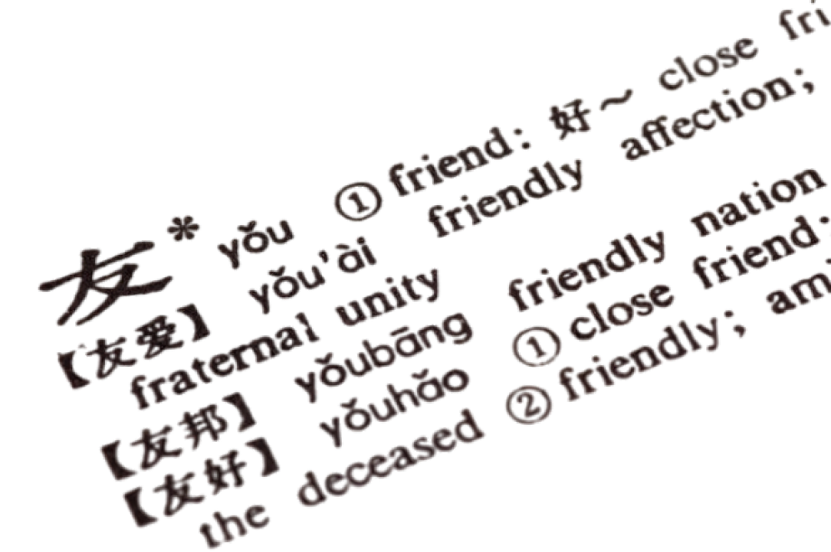
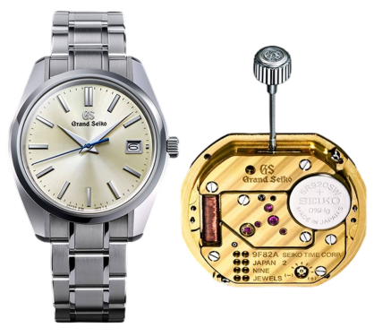
Quartz Watchmaking
Mandarin/Chinese Speaking
Piano/Keyboard:
Unlike traditional mechanical timepieces, quartz watches rely on the oscillation of a quartz crystal to maintain accurate timekeeping. This innovation, introduced in the 1960s, rapidly gained popularity due to its affordability, durability, and minimal maintenance requirements.
Mandarin, the most widely spoken Chinese dialect, serves as a linguistic bridge connecting over a billion people worldwide. Its contemporary relevance extends from bustling city streets to digital platforms, embodying the dynamic tapestry of modern China and its global influence.
Code | Level | Duration | Price (₹)
WCH-QW-BG | Beginner | 3 Months | 2399
WCH-QW-IN | Intermediate | 4 Months | 3899
Code | Level | Duration | Price (₹)
LAN-MA-BG | Beginner | 3 Months | 2299
LAN-MA-IN | Intermediate | 4 Months | 3799
LAN-MA-AD | Advanced | 7 Months | 7599

Slide 3
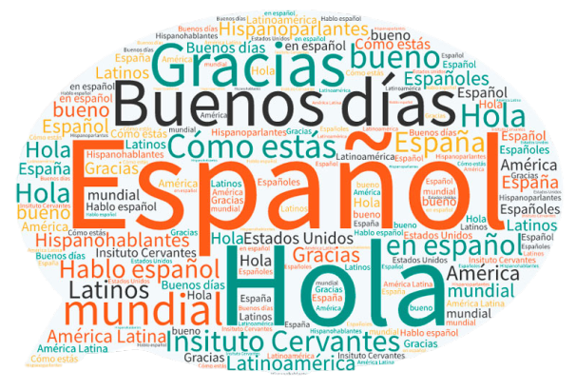
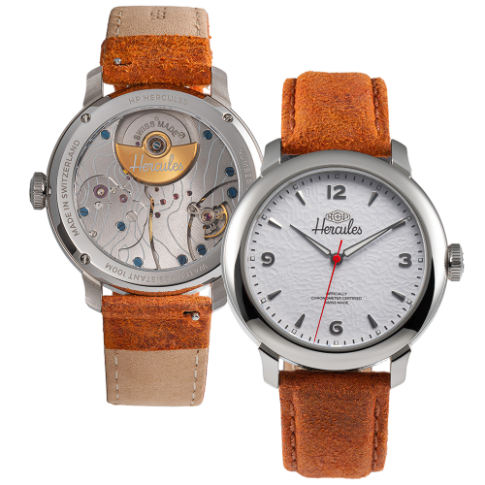
Spanish Speaking
Automatic Watchmaking
Piano/Keyboard:
Spanish, a Romance language with roots in Latin, is spoken by millions worldwide, making it one of the most prevalent languages globally. From the vibrant streets of Madrid to the bustling markets of Mexico City, Spanish connects people through its rich history and diverse expressions.
At its core, an automatic watch embodies the culmination of centuries-old traditions merged with cutting-edge technology. These watches, harness the natural motion of the wearer's wrist to power the intricate mechanisms within, eliminating the need for manual winding.
Code | Level | Duration | Price (₹)
LAN-SP-BG | Beginner | 3 Months | 2299
LAN-SP-IN | Intermediate | 4 Months | 3799
LAN-SP-AD | Advanced | 7 Months | 7599
Code | Level | Duration | Price (₹)
WCH-AW-BG | Beginner | 3 Months | 2599
WCH-AW-IN | Intermediate | 4 Months | 4199
WCH-AW-AD | Advanced | 7 Months | 7949

Slide 4
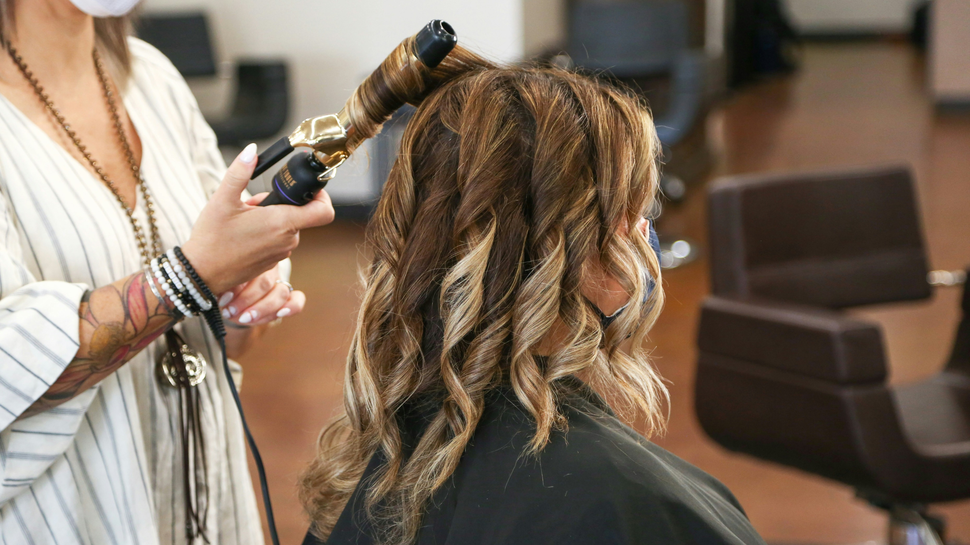
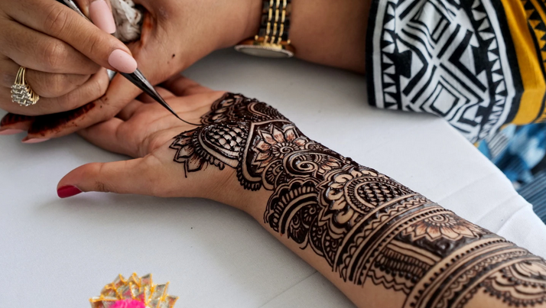
Hair Styling/Hair Dressing
Mehendi Art
Piano/Keyboard:
From classic cuts to avant-garde creations, hair styling involves a blend of technical expertise, creativity, and an understanding of individual preferences. Whether it's shaping, coloring, or embellishing hair, hairdressers wield their tools with precision to transform looks into expressions of style and beauty.
Mehendi is a traditional form of body art originating from the Indian subcontinent, Middle East and North Africa. It involves applying intricate designs using a paste made from the powdered leaves of the henna plant. It is often used to adorn hands and feet for weddings, festivals and occasions.
Code | Level | Duration | Price (₹)
HSD-HS-BG | Beginner | 3 Months | 2299
HSD-HS-IN | Intermediate | 4 Months | 3799
HSD-HS-AD | Advanced | 8 Months | 7549
Code | Level | Duration | Price (₹)
TTR-MA-BG | Beginner | 3 Months | 2399
TTR-MA-IN | Intermediate | 5 Months | 4499

Slide 5
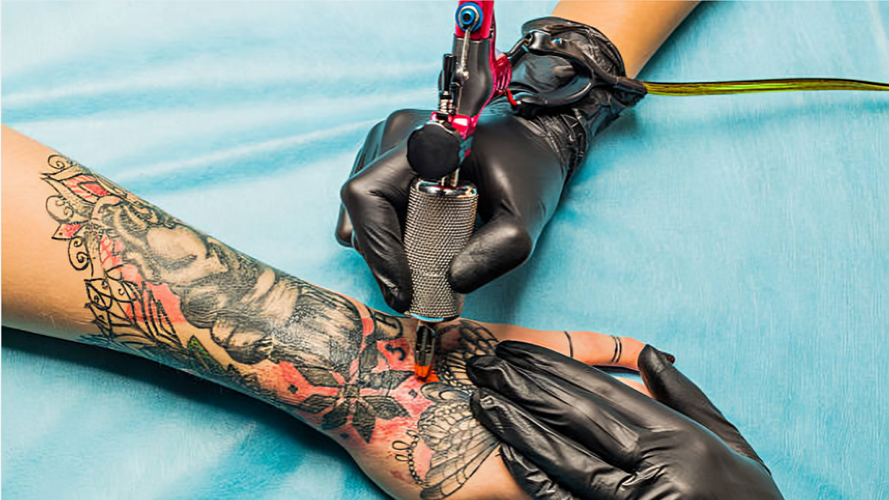
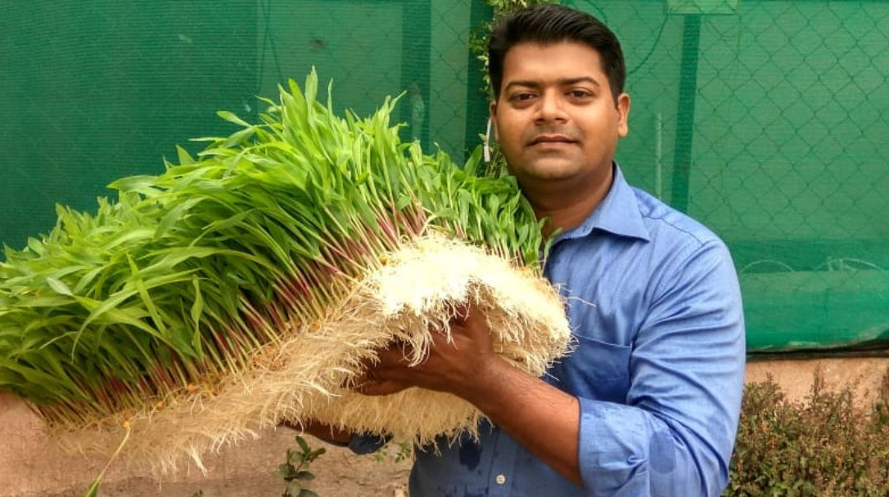
Tattoo Art
Organic Hydrophonic Farming
Piano/Keyboard:
Tattoos have transcended their historical significance to become intricate works of creativity, personal narrative, and aesthetic beauty. In contemporary society, tattooing serves as a vibrant canvas for individuals to etch their stories, beliefs, and identities onto their skin, forever marking moments in time.
Hydroponic farming is a novel approach to cultivating crops without soil. By eliminating the need for soil, organic hydroponics minimizes water usage, reduces the risk of soil-borne diseases, and maximizes space efficiency. Embracing organic principles, this method prioritizes economic natural inputs.
Code | Level | Duration | Price (₹)
TTR-TA-BG | Beginner | 3 Months | 2699
TTR-TA-IN | Intermediate | 4 Months | 4299
TTR-TA-AD | Advanced | 7 Months | 8049
Code | Level | Duration | Price (₹)
FAR-OH-BG | Beginner | 3 Months | 3199
FAR-OH-IN | Intermediate | 4 Months | 4799
FAR-OH-AD | Advanced | 9 Months | 8449

Slide 6
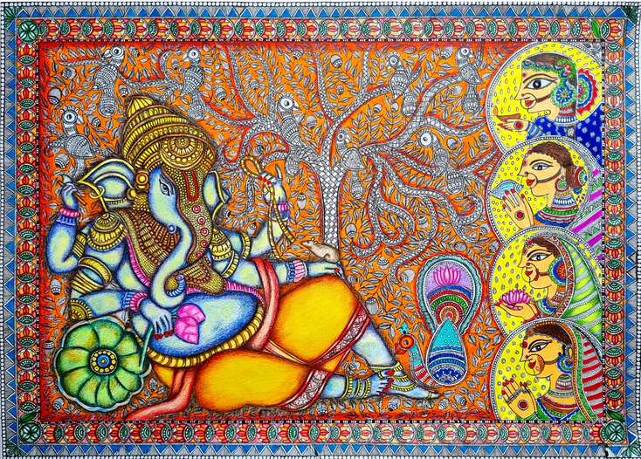
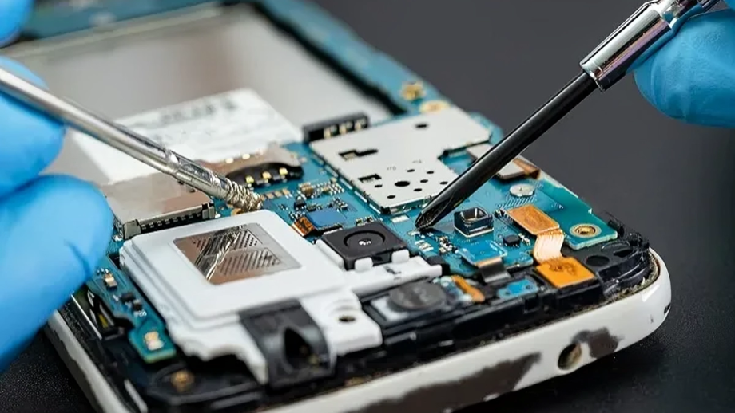
Smartphone Device Hardware Repair
Madhubani Painting
Piano/Keyboard:
Device hardware repair involves diagnosing and fixing issues with the physical components of smartphones, tablets, and other handheld devices. Common issues include broken screens, malfunctioning buttons, water damage, battery issues etc.
Also known as Mithila art, it originates from the Mithila region of India & Nepal. It is renowned for its vibrant colors, intricate patterns, and cultural significance, often depicting scenes from Hindu mythology.
Code | Level | Duration | Price (₹)
MCR-SH-BG | Beginner | 3 Months | 2199
MCR-SH-IN | Intermediate | 4 Months | 3699
MCR-SH-AD | Advanced | 7 Months | 7449
Code | Level | Duration | Price (₹)
CRA-MP-BG | Beginner | 3 Months | 2499
CRA-MP-IN | Intermediate | 4 Months | 3999
CRA-MP-AD | Advanced | 7 Months | 7749

Slide 7
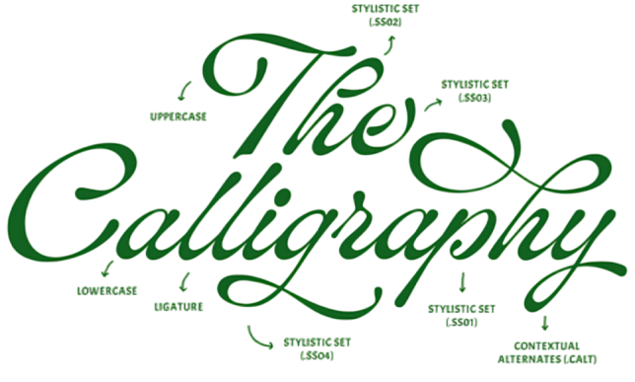

Calligraphy
Smartphone Device Software Repair
Piano/Keyboard:
From troubleshooting operating system glitches to addressing application malfunctions, software repair services ensure optimal device performance and functionality. It includes diagnosing and resolving software-related issues in devices.
Calligraphy, originating in ancient times, is the exquisite art of combining precise letter shapes with expressive creativity. It's revered worldwide for its intricate designs and cultural significance.
Code | Level | Duration | Price (₹)
CRA-CL-BG | Beginner | 3 Months | 2299
CRA-CL-IN | Intermediate | 5 Months | 3999
Code | Level | Duration | Price (₹)
MCR-SS-BG | Beginner | 3 Months | 2299
MCR-SS-IN | Intermediate | 4 Months | 3799
MCR-SS-AD | Advanced | 7 Months | 7549

Slide 8
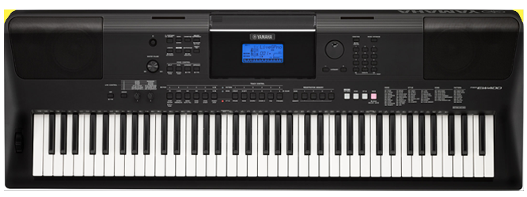
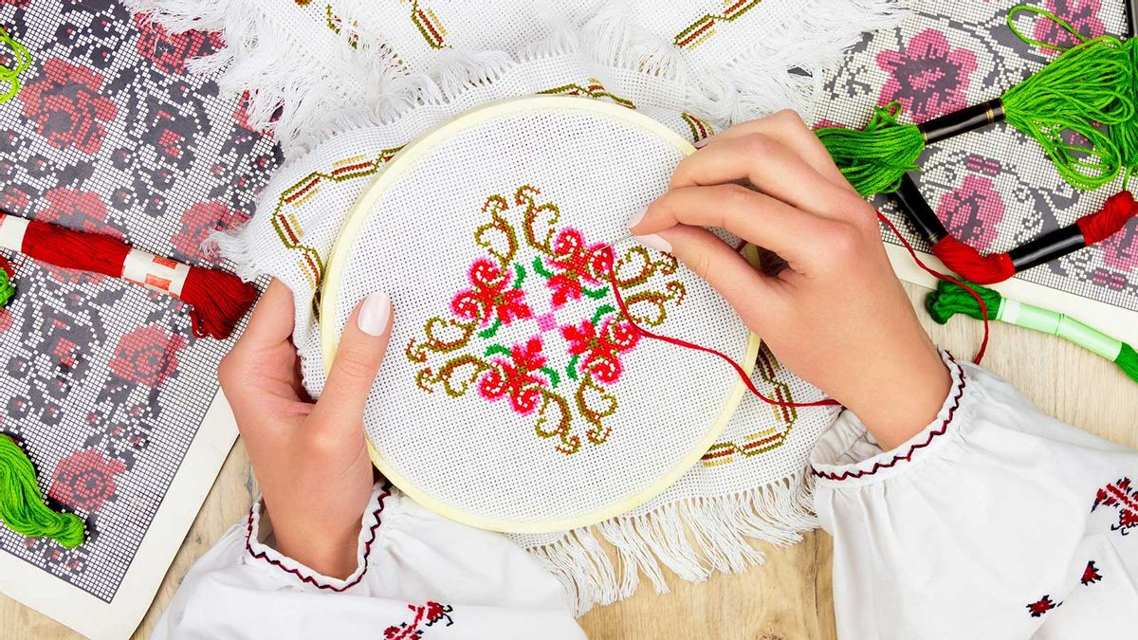
Piano/Keyboard
Hand Weaving and Embroidery
Piano/Keyboard:
Pianos and keyboards, from grand instruments to portable keyboards, have captivated audiences for centuries with their enchanting melodies and expressive range. Their versatility allows musicians of all genres to create everything from classical masterpieces to modern pop hits, making them essential tools for musical expression.
Hand embroidery is the art of decorating fabric with needle and thread, weaving intricate designs and patterns by hand. There are many types of floss, yarn and fibers to stitch with, as well as a plethora of stitches to use. Hand Embroidery adds a decorative element to quilts, garments and accessories.
Code | Level | Duration | Price (₹)
MUS-PI-BG | Beginner | 3 Months | 2399
MUS-PI-IN | Intermediate | 4 Months | 3899
MUS-PI-AD | Advanced | 7 Months | 7649
Code | Level | Duration | Price (₹)
CRA-WE-BG | Beginner | 3 Months | 2499
CRA-WE-IN | Intermediate | 5 Months | 3999
CRA-WE-AD | Advanced | 9 Months | 7749

Slide 9
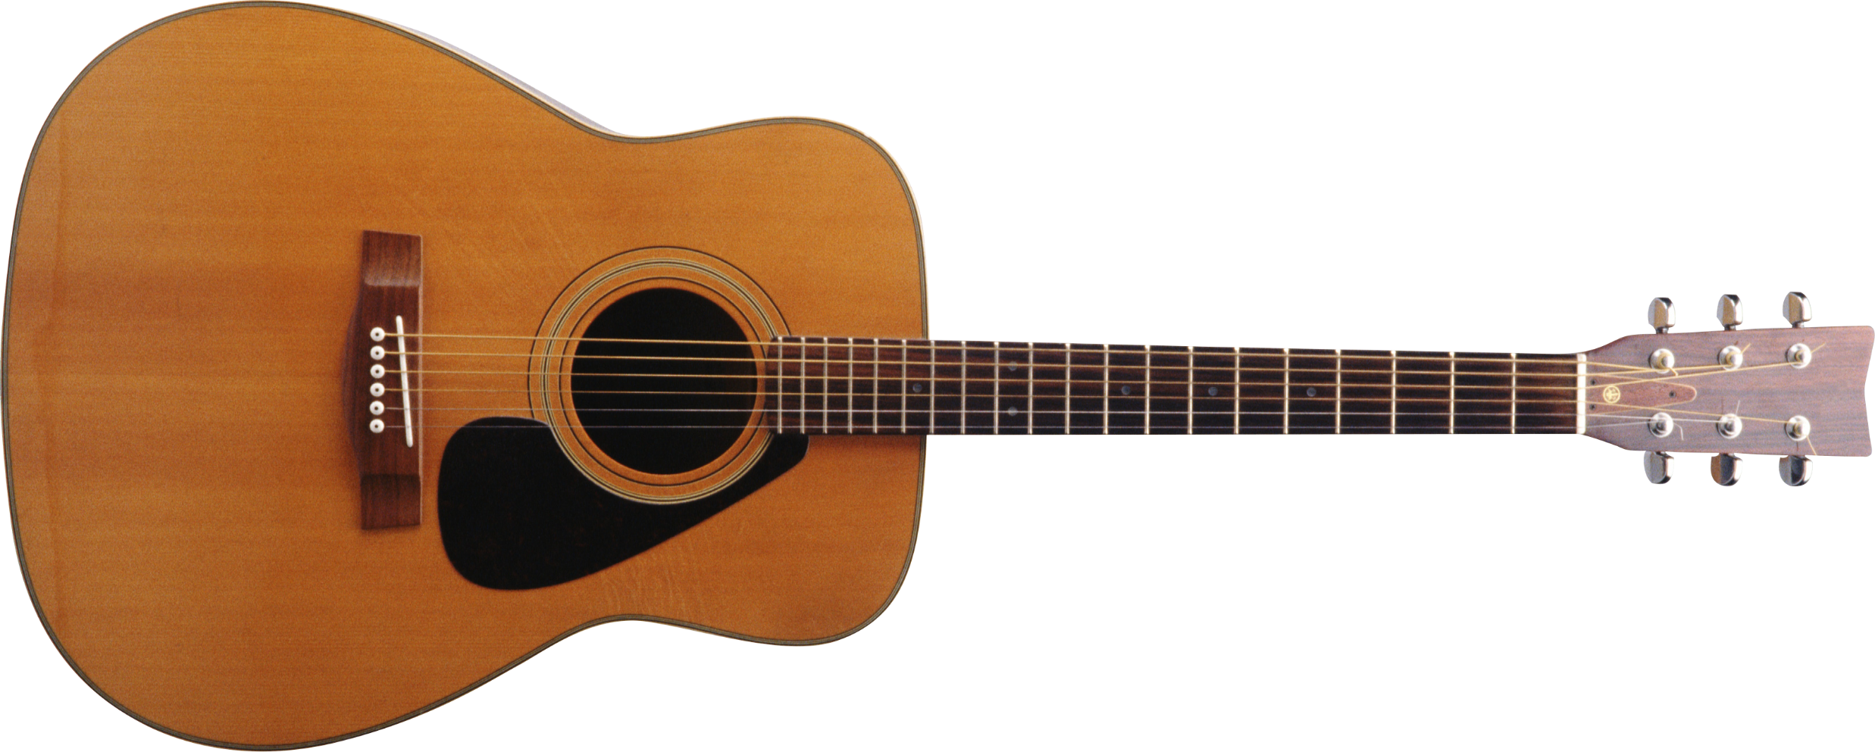
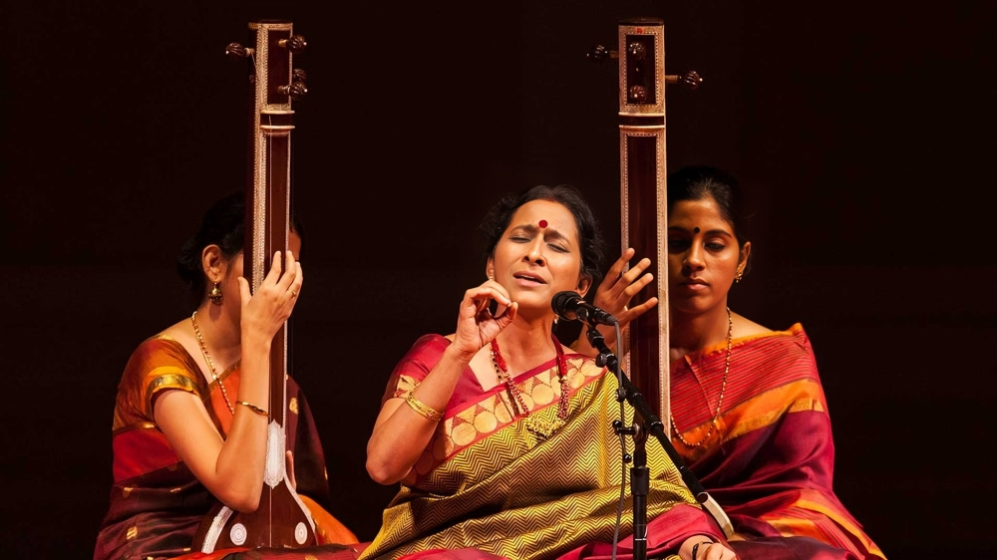
Carnatic Music
Acoustic Guitar
Piano/Keyboard:
The acoustic guitar, a cornerstone of modern music, is renowned for its timeless charm. Its distinctive sound, produced by steel or nylon strings on a hollow body, resonates across genres from folk to rock. With its elegant design and warm tones, it captivates audiences worldwide, whether strummed gently or played with vigor.
The Carnatic music, a classical tradition originating from southern India, is a rich tapestry of melodic intricacies and rhythmic complexities. Rooted in ancient Sanskrit texts and steeped in devotion, this art form explores a vast array of ragas (melodic scales) and talas (rhythmic cycles).
Code | Level | Duration | Price (₹)
CRA-CM-BG | Beginner | 3 Months | 2549
CRA-CM-IN | Intermediate | 4 Months | 4099
CRA-CM-AD | Advanced | 7 Months | 7749
Code | Level | Duration | Price (₹)
MUS-AG-BG | Beginner | 3 Months | 2599
MUS-AG-IN | Intermediate | 4 Months | 4199
MUS-AG-AD | Advanced | 7 Months | 7949

Slide 10
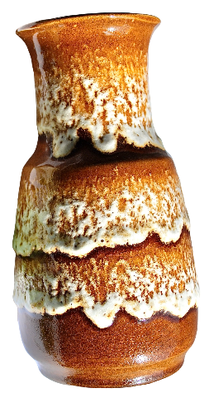
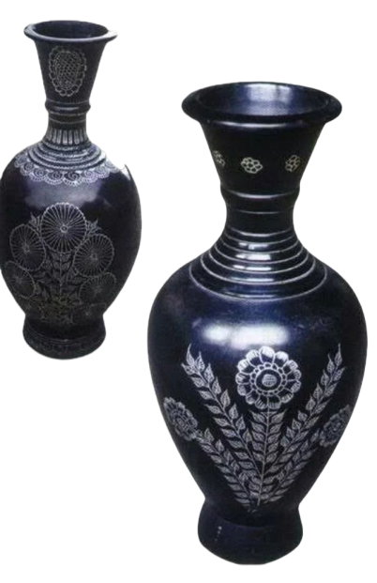
Ochre Colored Pottery
Northern Black Polished Ware Pottery
Piano/Keyboard:
This is a Bronze Age culture of the Indian Ganges plains. It extends from eastern Punjab to northeastern Rajasthan and western Uttar Pradesh. In the recent years, this art has gained popularity and is used in combination with modern paints, crafted using a variety of techniques, including wheel throwing and hand molding.
NBPW pottery is characterized by its distinctive lustrous black surface and fine craftsmanship. It is casted on high speed wheels for an impressive glossy
finish. 90% of this type is jet black, brownish black, or bluish-black, and 10% have colors such as pink, gold & brown.
Code | Level | Duration | Price (₹)
POT-OC-BG | Beginner | 3 Months | 2499
POT-OC-IN | Intermediate | 4 Months | 3999
POT-OC-AD | Advanced | 7 Months | 7749
Code | Level | Duration | Price (₹)
POT-NB-BG | Beginner | 3 Months | 2649
POT-NB-IN | Intermediate | 4 Months | 4299
POT-NB-AD | Advanced | 8 Months | 7949

